Slide 1
Automation
Python for

Slide 2
Patrick Staudt, CFA
Developing Python scripts for astrophysics research since 2017
Currently learning Julia
VBA since 2011
A stint of C++ in 2008
Ph.D. candidate, Physics, UC Irvine, 2026
M.S., Astronomy and Astrophysics, UC Irvine, 2023
B.S., Astrophysics, Rutgers, January 2020
B.S., Management, UConn, May 2010

Slide 3
What is Automation good for?

Slide 4

Text

Slide 5


Slide 6
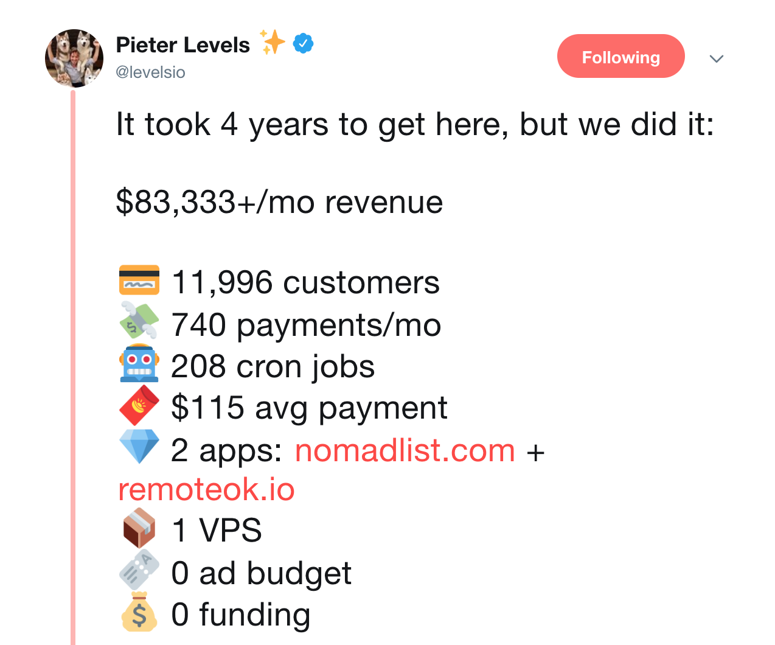
Nomad List

Slide 7
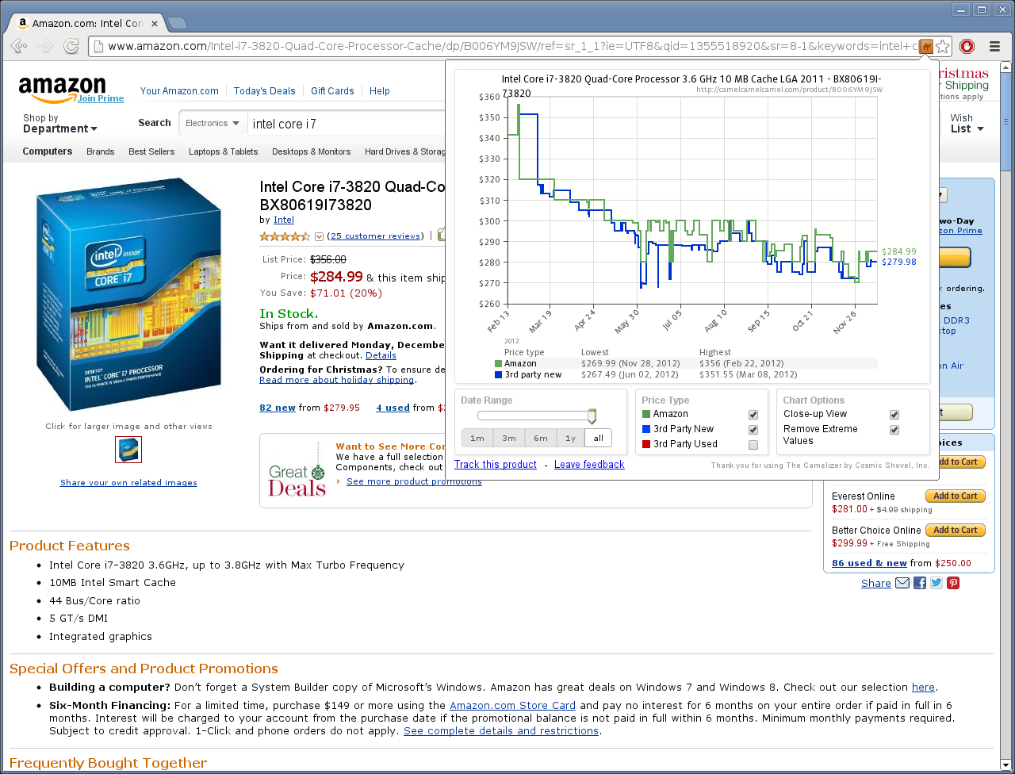
camelcamelcamel

Slide 8
Class format

Slide 9

Class format
10 minutes for lesson & demo
15 minutes for exercise
Pause to review & ask questions
Rinse and repeat

Slide 10
Demo

Slide 11
HTML & CSS Selectors

Slide 12

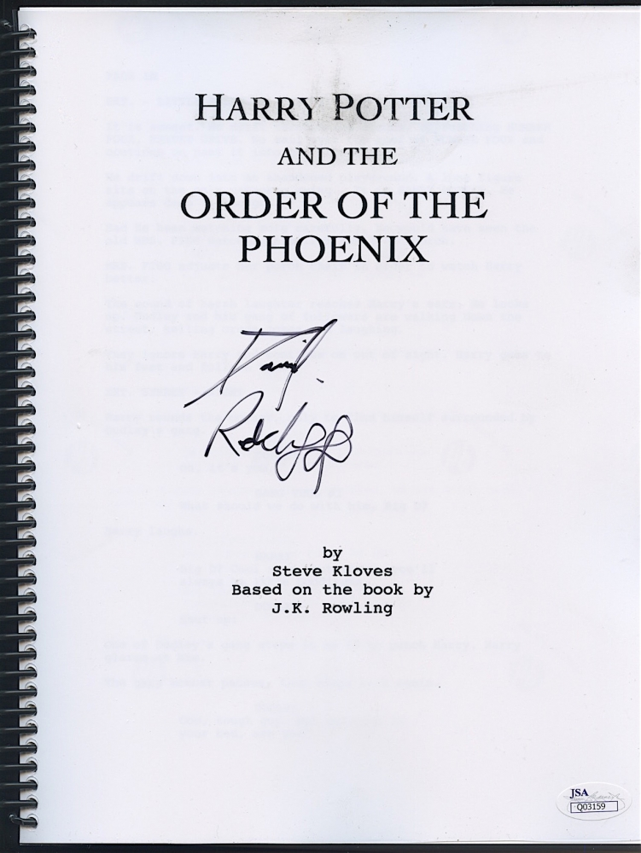
Website
HTML

Slide 13
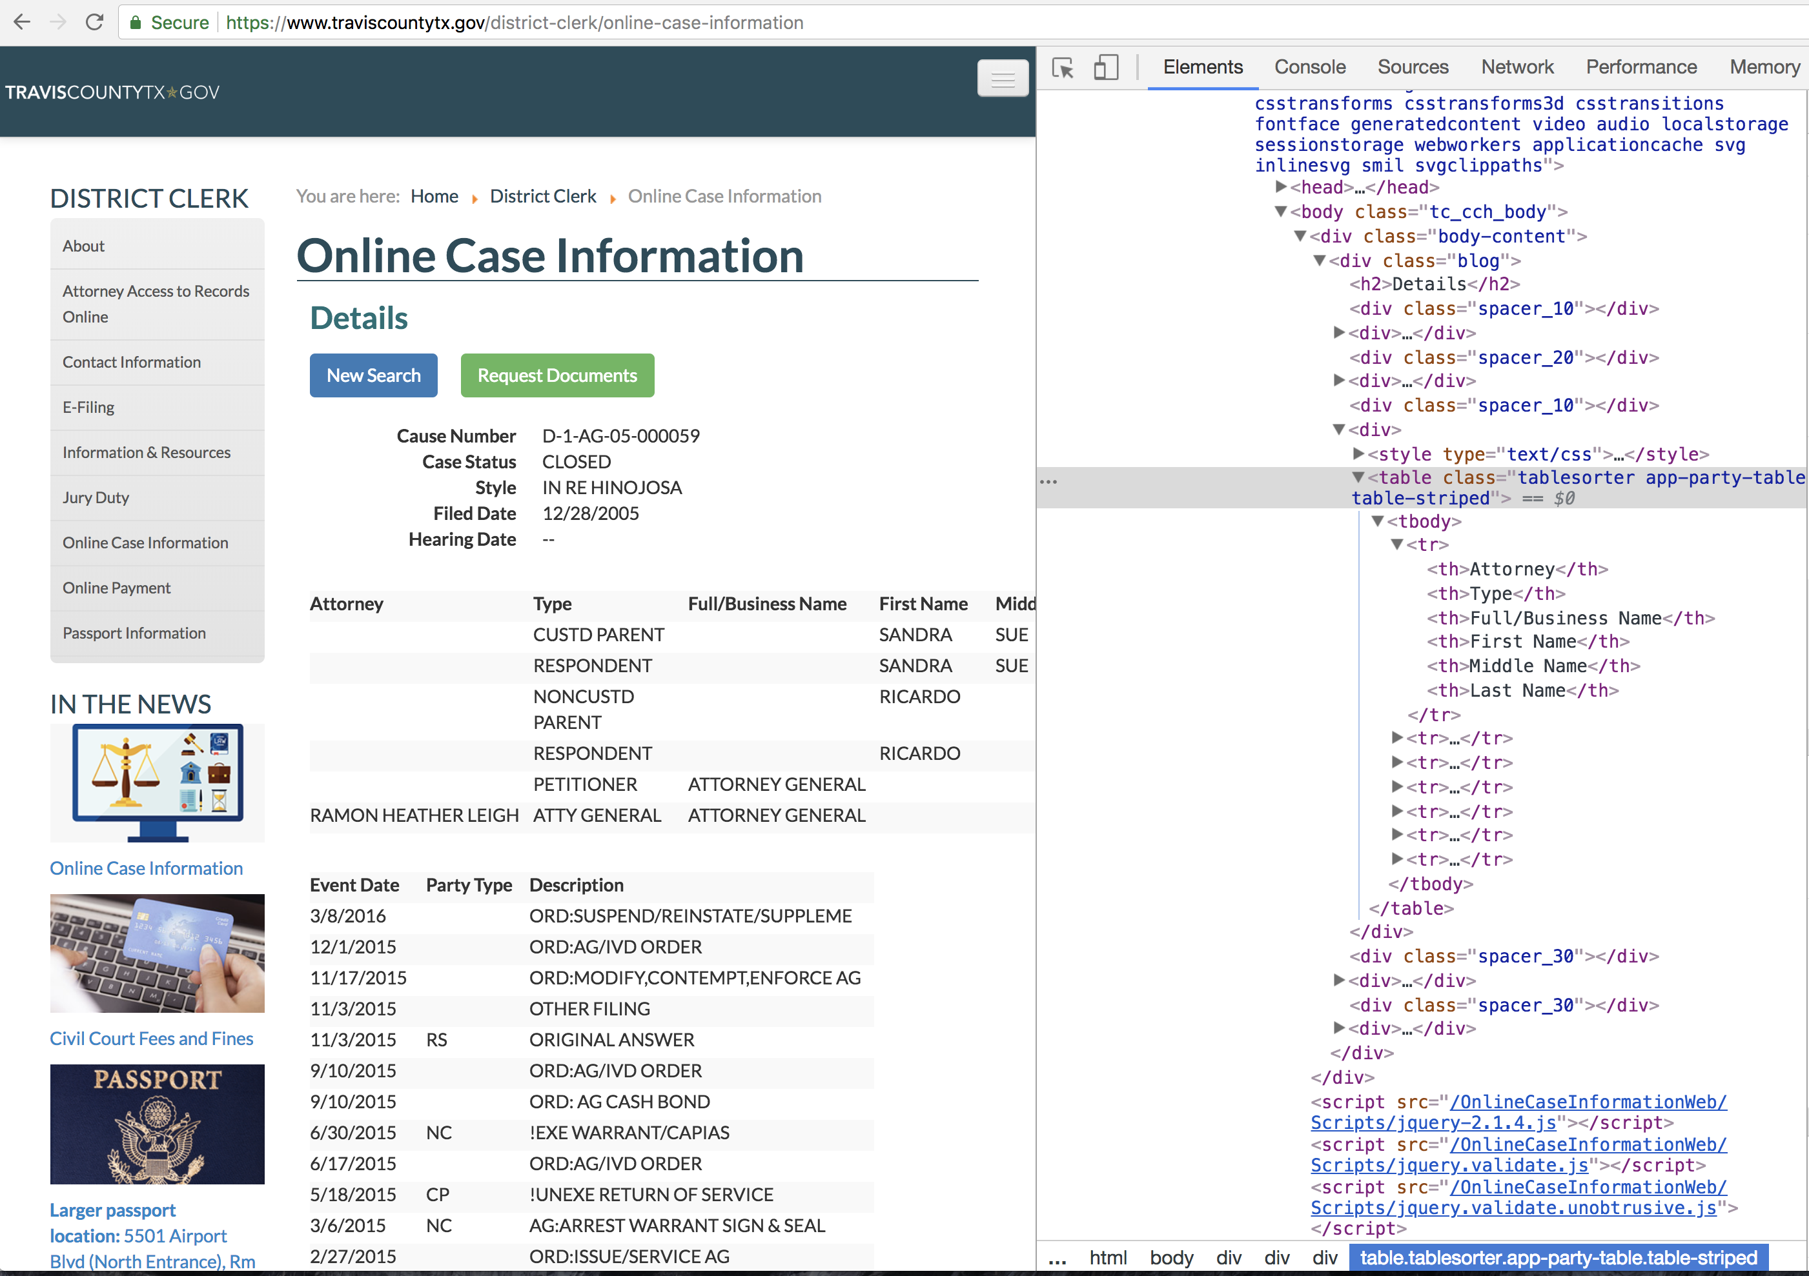

Slide 14
Anatomy of an HTML ELEMENT
<body>text goes in here</body>

Slide 15
Anatomy of an HTML ELEMENT
<body>text goes in here</body>
Tag indicates part of the webpage

Slide 16
Anatomy of an HTML ELEMENT
<body>
<h2 id=“title”>a header</h2>
</body>

Slide 17
Anatomy of an HTML ELEMENT
<body>
<h2 id=“title”>a header</h2>
</body>
Element has attributes like id, class, etc

Slide 18
Css Selectors
Tag —> h2
id —> #title
Class —> .header
Attribute —> [name=“ssn”]
Notes:
ID is meant to be unique Class is not meant to be unique

Slide 19
Combining selectors
.main#feature

Slide 20
selecting Child Elements
#hello > a

Slide 21
Exercises

Slide 22
On a Craigslist Post
Pick out only the title text
Grab the price
Use Chrome’s element selector to jump to the <time> by clicking the post time on the ad.
By using the inspector’s find feature, cycle through all the images under the div with id “thumbs”
Notes:
div.swipe-wrap>div>img
-all the image tags nested under swipe-wra

Slide 23
On a Craigslist Post
EXTRA CREDIT: nth-child()
Determine the CSS selector that leads directly to and only to the post-id from the bottom of the page
When cycling through a number of children, you can add :nth-child(1) to grab just the first child.
Notes:
.postinginfos>p:nth-child(1)
-the 1st p tag under .postinginfos

Slide 24

Selenium
Automating chrome with

Slide 25

Text

Slide 26
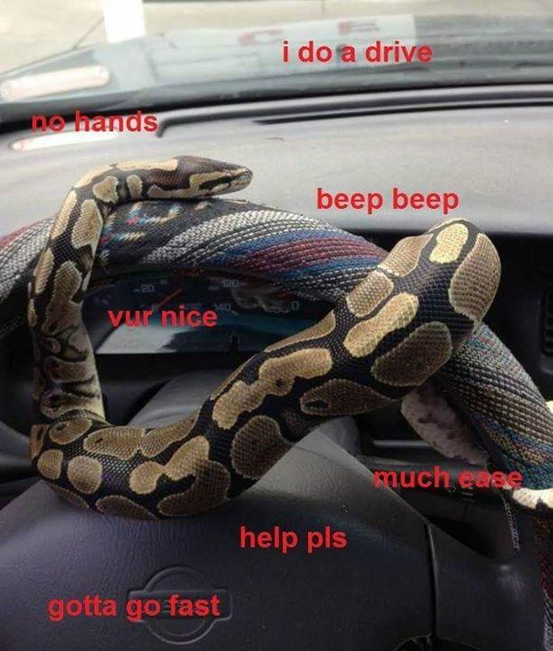

Slide 27



Chrome Driver

Slide 28
importing selenium
from selenium import webdriver

Slide 29
chrome web driver
ARM MAC
webdriver.Chrome(“./chromedriver_arm")
OLDER MAC
webdriver.Chrome(“./chromedriver")
WINDOWS
webdriver.Chrome(“./chromedriver.exe")

Slide 30
Navigating to URL
driver.get(“www.craigslist.com”)

Slide 31
Selecting links
.find_element (”link text”, “next”)

Slide 32
Selecting anything
.find_element (”css selector”, “p”)

Slide 33
Exercises

Slide 34
Extract text
element.text

Slide 35
extract attribute
element.get_attribute(“href”)

Slide 36
Input text into fields
element.send_keys(“how to surf”)

Slide 37
Take a screenshot
driver.save_screenshot(“me.jpg”)

Slide 38

Files and Loops

Slide 39
reading from files
f = open(“story.txt”)

Slide 40
reading from files
f.read()
'coffee table,furniture,5,15\nhero with a thousand faces,books,10,20'

Slide 41
reading from files
f.close()

Slide 42
Problem #1
Nobody remembers to close()
Needs to be automatic instead

Slide 43
Context managers
with open(“story.txt”) as f:
# Do stuff

Slide 44
Problem #2
Don’t want to read() entire file!
Just give me one line at a time

Slide 45
readlines
f.readlines()
[‘coffee table,furniture,5,15’,
…
‘hero with a face,books,10,20’]

Slide 46
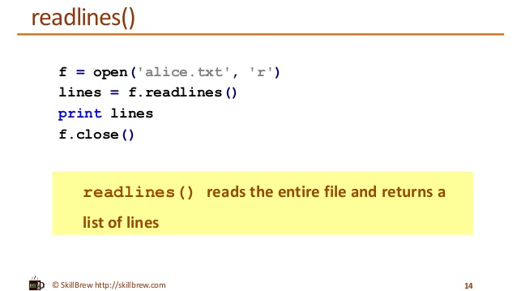

Slide 47
readlines
with open(“story.txt”) as f:
for line in f.readlines():
# Handle one line

Slide 48
Split
“id, name, date”.split(“,”)
[“id”, “ name”, “ date”]

Slide 49
Python review

Slide 50
Values: What kinds ARE THERE?
Int
Float
String

Slide 51
Mixing data types
1 + 7.0 = 8.0

Slide 52
Mixing data types
1 + 7.0 = 8.2
1 + “7.0” = error

Slide 53
Mixing data types
1 + 7.0 = 8
1 + int(“7.0”) = 8.0

Slide 54
For-Loops
Repeats a chunk of code
Hands in different item each time

Slide 55
For-loops
pets = [“dog”, “cat”, “fish”]
for pet in pets:
print(pet)

Slide 56
For-loops
pets = [“dog”, “cat”, “fish”]
for pet in pets:
print(“dog”)

Slide 57
For-loops
pets = [“dog”, “cat”, “fish”]
for pet in pets:
print(“cat”)

Slide 58
Exercises

Slide 59

Gmail
automating

Slide 60
Yagmail
import yagmail

Slide 61
Yagmail
#E.g.: email address is johndoe@gmail.com
username = ‘johndoe’ #only text before the `@`
password = ‘password’
yag = yagmail.SMTP(username, password)
#E.g. target email address is janedoe@gmail.com
tgt_email = ‘janedoe@gmail.com’
yag.send(tgt_email, 'subject', ‘msg’)

Slide 62
Email-text message gateway
Provided by phone carriers
Converts e-mail to text
Free! But slow

Slide 63
Exercises

Slide 64
Improvements
Only search near your ZIP code
Limit output to 10 results
Exclude results based on words that indicate a scam

Slide 65
Projects

Slide 66

Automated email
Response

Slide 67

Automated
Research

Slide 68

Alert
Automated ticket

Slide 69
Advanced Topics

Slide 70
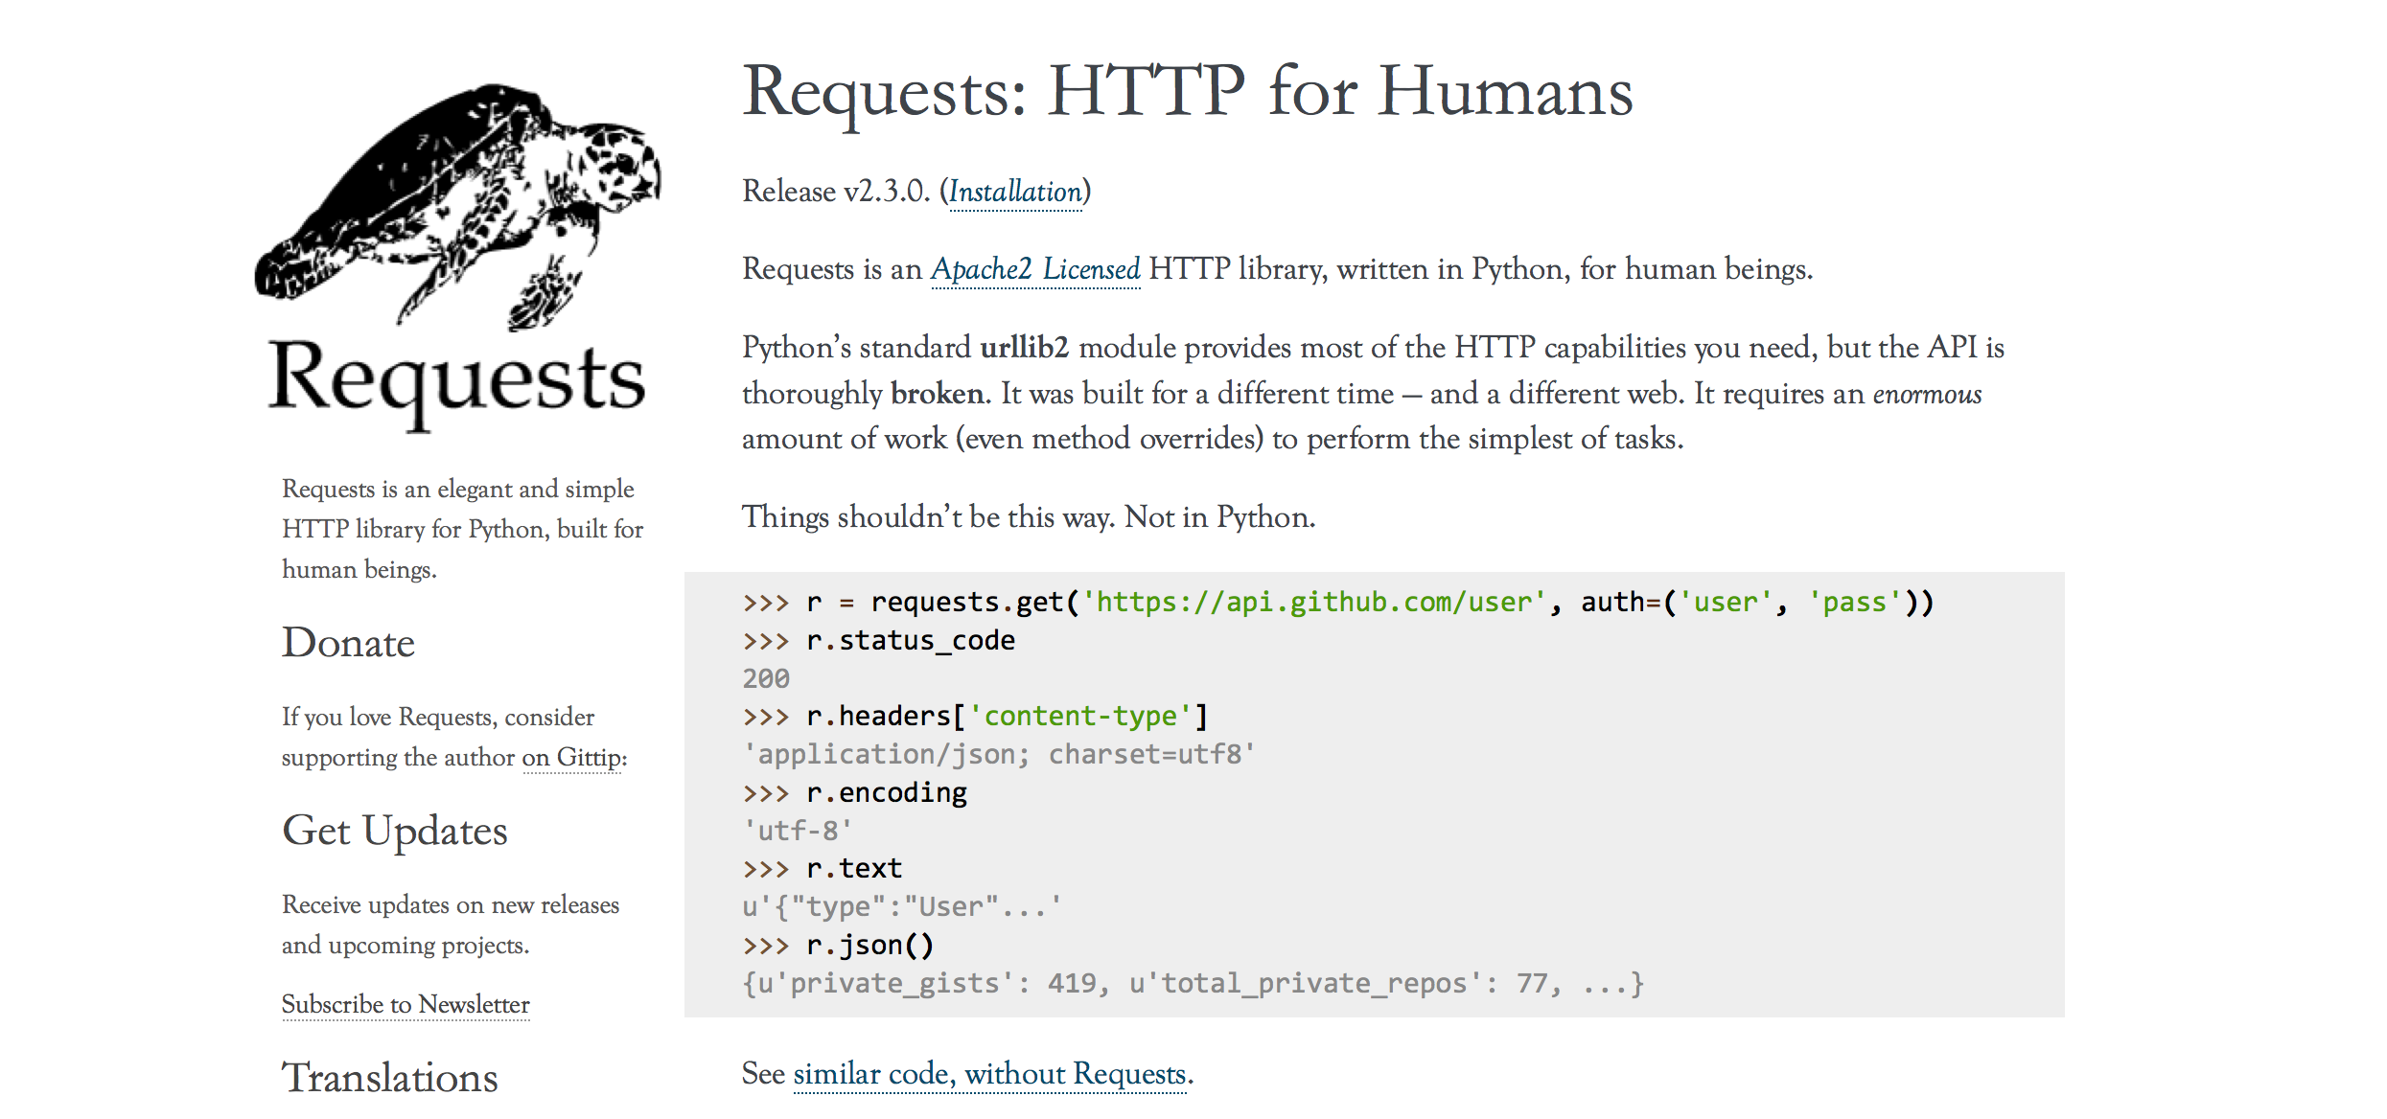
Text

Slide 71
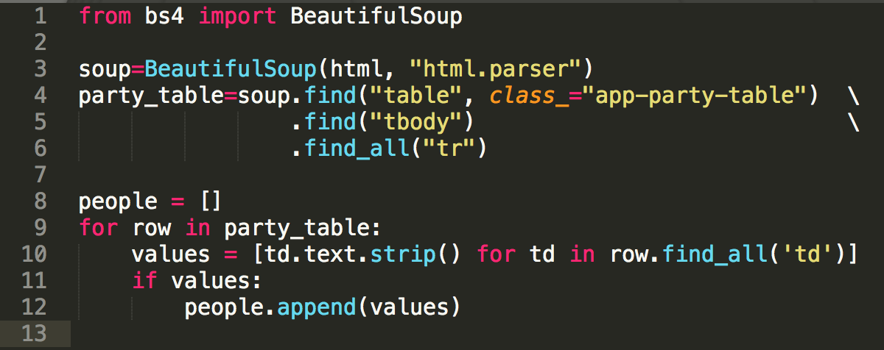
Beautiful Soup
Helps Python extract data from HTML

Slide 72
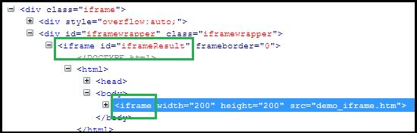
iframes

Slide 73

APIs
Made for robots, not human eyeballs
Like a website without the visuals

Slide 74
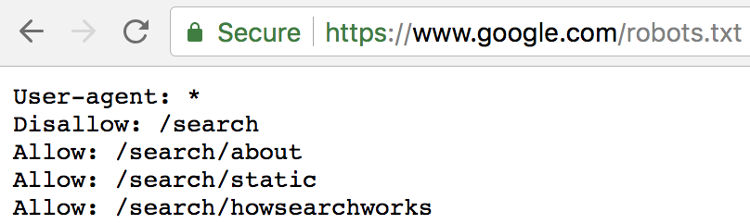
robots.txt
Tells webscraping programs where they should/shouldn’t go

